Slide 1


Department of Information Science and Engineering
UNIVERSITY VISVESVARAYA COLLEGE OF ENGINEERING DEPARTMENT OF COMPUTER SCIENCE
Application of Deep Learning in Medical Image Classification and Segmentation
TEAM MEMBERS
A Shriya (19GANSE001)
Harishankara H V (19GANSE017)
Kushal B (19GANSE024)
Mohammed Danish Rabbani (19GANSE028)
GUIDE Dr. Thriveni J Professor, Dept of CSE, UVCE
Date-11-07-2023

Slide 2
Acknowledgements
We would like to express our heartfelt gratitude to the following faculty:
Dr Jayakara S M, Vice Chancellor, Bangalore University
Dr H N Ramesh, Principal, UVCE
Dr Vimala H S, Chairperson, Department of CSE
Dr Thriveni J, Professor, Department of CSE

Slide 3
Contents
Introduction
Problem Statement
Project Focus
Methodology
System Requirements
System Design
System Architecture
Implementation
Performance Metrics
Performance Analysis
Conclusion and Future Work
References

Slide 4
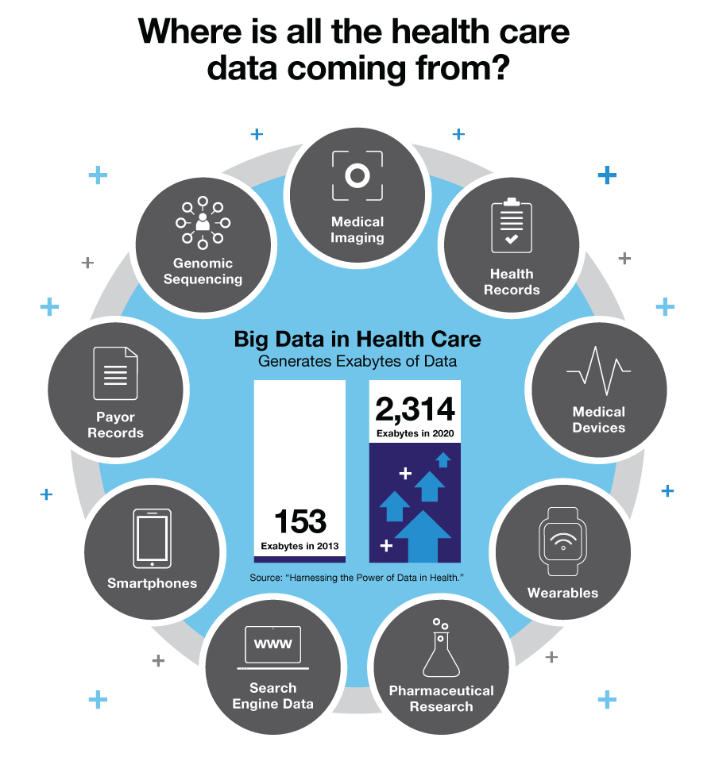
Background

Slide 5
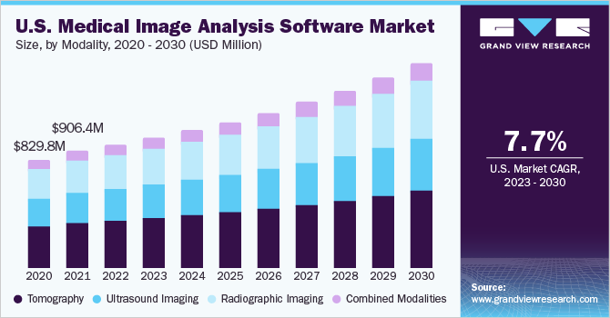
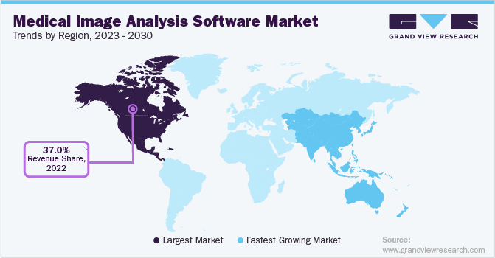
Background
Source: https://www.grandviewresearch.com/industry-analysis/medical-image-analysis-software-market

Slide 6
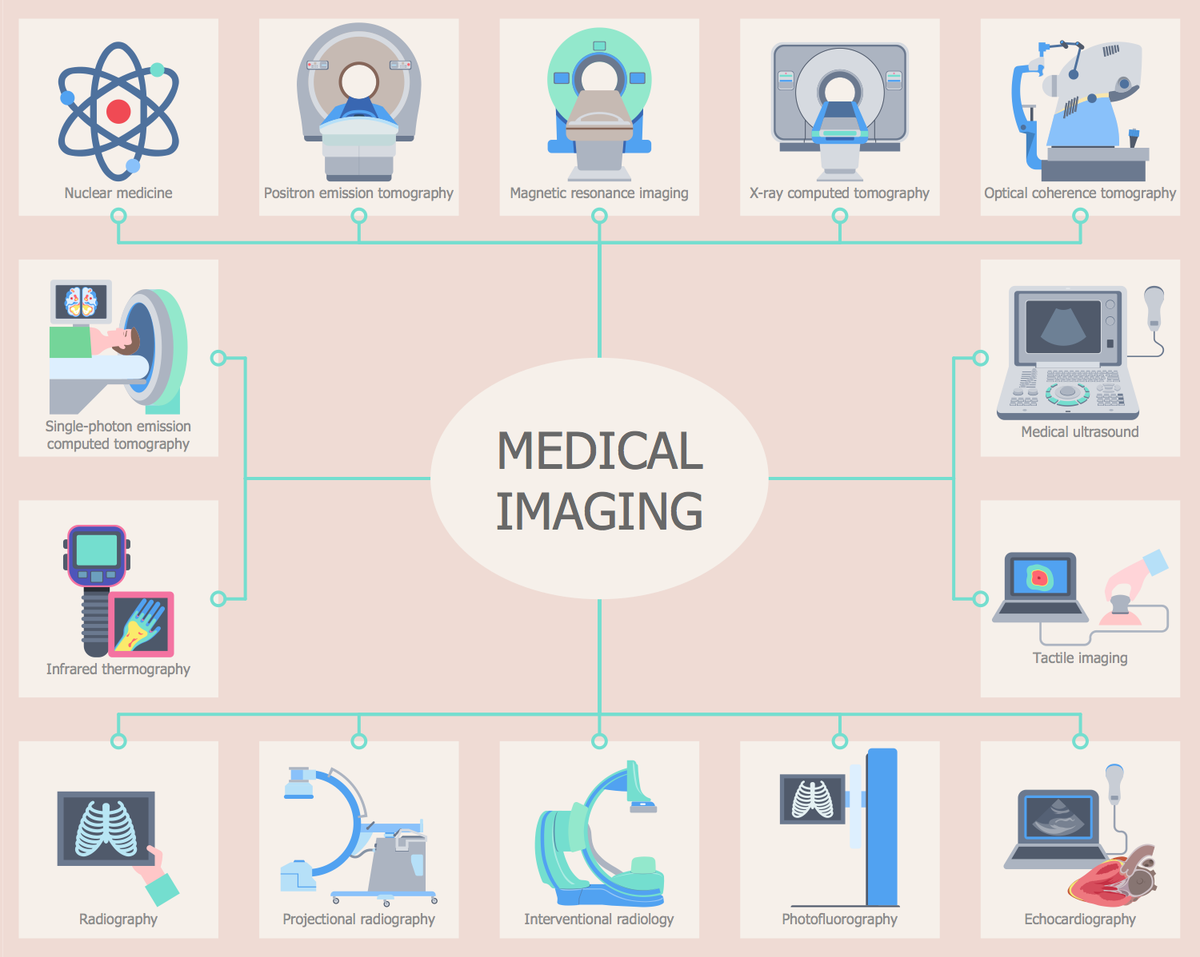
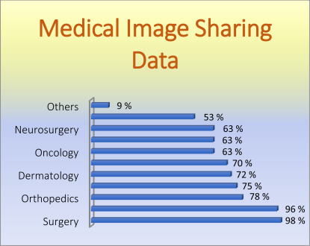
Background

Slide 7
Problem Statement
Background: Medical image data account for the vast majority of medical data.
Problem: How to utilise big medical data for best clinical practices to improve diagnosing techniques?
Solution: Using intelligent imaging and deep learning in the field of big data analysis, combining the latest research progress and the work in the field, especially the classification and segmentation of medical images.
Outcome: Early diagnosis of diseases

Slide 8
Project Focus
Medical Image Segmentation
Brain Tumor Segmentation
Medical Image Classification
Acute Lymphoblastic Leukemia
Brain Cancer
Breast Cancer
Cervical Cancer
Kidney Cancer
Lung Cancer
Colon Cancer
Lymphoma
Oral Cancer

Slide 9
Methodology
Transfer learning for Classification Models
Transfer learning is a machine learning technique where knowledge gained from solving one problem is applied to a different but related problem.
In transfer learning, a pre-trained model that has been trained on a large dataset and has learned useful patterns and representations is utilized as a starting point for solving a new task.

Slide 10
Methodology
Ensembling
Machine learning technique where multiple models are combined to make predictions
Using strengths of different models and reducing individual model errors for improved accuracy
Reduces the risk of overfitting, enhances stability, and leverages the "wisdom of the crowd" principle

Slide 11
System Requirements
Hardware Requirements
Intel i7 or higher
16 GB RAM or higher
12 GB CPU
Software Requirements
Python 3.0 or higher
Jupyter
VSCode
Python Libraries: Pandas, Torchvision, Matplotlib, Numpy, Sklearn, Keras, TensorFlow, PyTorch, Monai

Slide 12
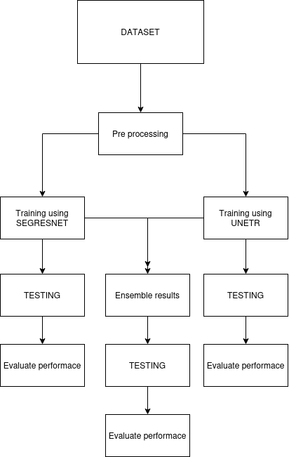
System Design
System Design for
Brain Tumor Segmentation

Slide 13
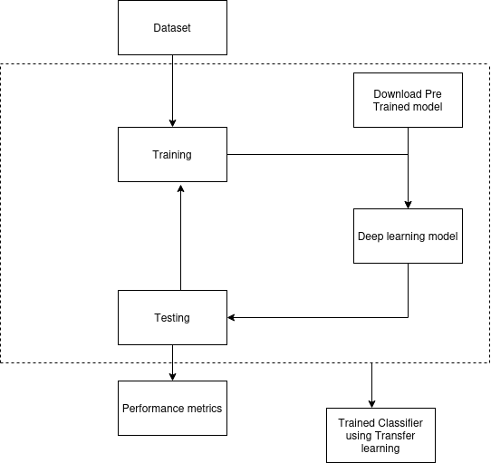
System Design
System Design for
Classification

Slide 14
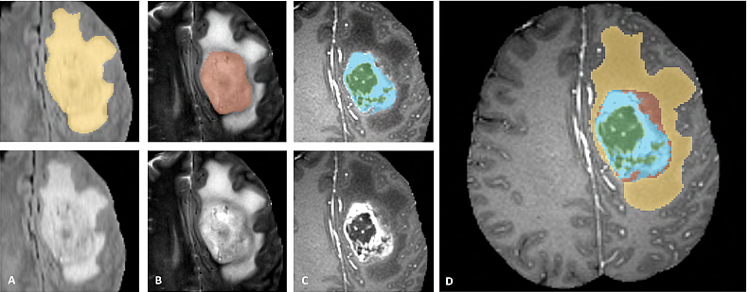
System Architecture
System Architecture for Brain Tumor Segmentation
Dataset:
Size: 750 4D volumes (484 Training + 266 Testing) MRI images
Types: FLAIR, T1w, T1gd, T2w
Sources: BRATS 2016 and 2017
Glioma Sub-Regions

Slide 15
System Architecture
System Architecture for Brain Tumor Segmentation
Each MRI has 3 label images (Ground truth). The labels are:-
Label 1 is the peritumoral edema
Label 2 is the GD-enhancing tumor
Label 3 is the necrotic and non-enhancing tumor core
These labels are converted to brats classes which are TC (Tumor core), WT (Whole tumor) and ET (Enhancing tumor).
System Architecture for Brain Tumor Segmentation
Label 2 and label 3 are merged to construct the tumor core.
Label 1, label 2 and label 3 are merged to construct Whole tumor.
Label 2 is enhancing tumors.
Each Image is cropped to a specific dimension.

Slide 16
System Architecture
System Architecture for Brain Tumor Segmentation
Data Augmentation:
Transform the data by randomly adjusting the intensity and producing rotations and flips of the MRI image.
We apply a random (per channel) intensity shift (−0.1..0.1 of image std) and scale (0.9..1.1) on input image channels. We also apply a random axis mirror flip (for all 3 axes) with a probability 0.5.
Modeling:
2 architectures: SegResNet and UNETR

Slide 17
System Architecture
Cancer | Classes | Images
Acute Lymphoblastic Leukemia | 4 | 20000
Brain Cancer | 3 | 15000
Breast Cancer | 2 | 10000
Cervical Cancer | 5 | 25000
Kidney Cancer | 2 | 10000
Lung and Colon Cancer | 5 | 25000
Lymphoma | 3 | 15000
Oral Cancer | 2 | 10000
System Architecture for Classification
Dataset:
Multi-cancer dataset from Kaggle
5000 images in each sub-class
Image size 512x512
Pre-processing:
Data Normalization
Image pre-processing
Modeling:
CNN - ResNet, MobileNet, VGGNet, DenseNet

Slide 18
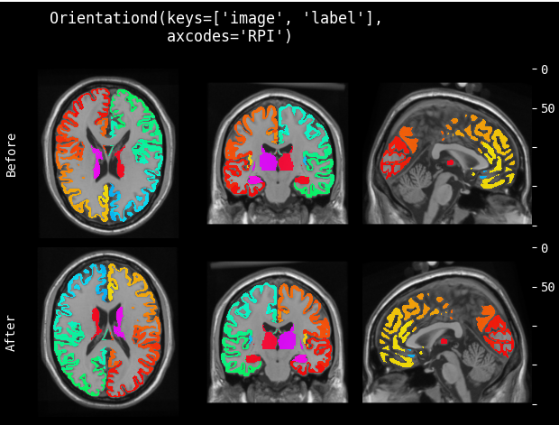
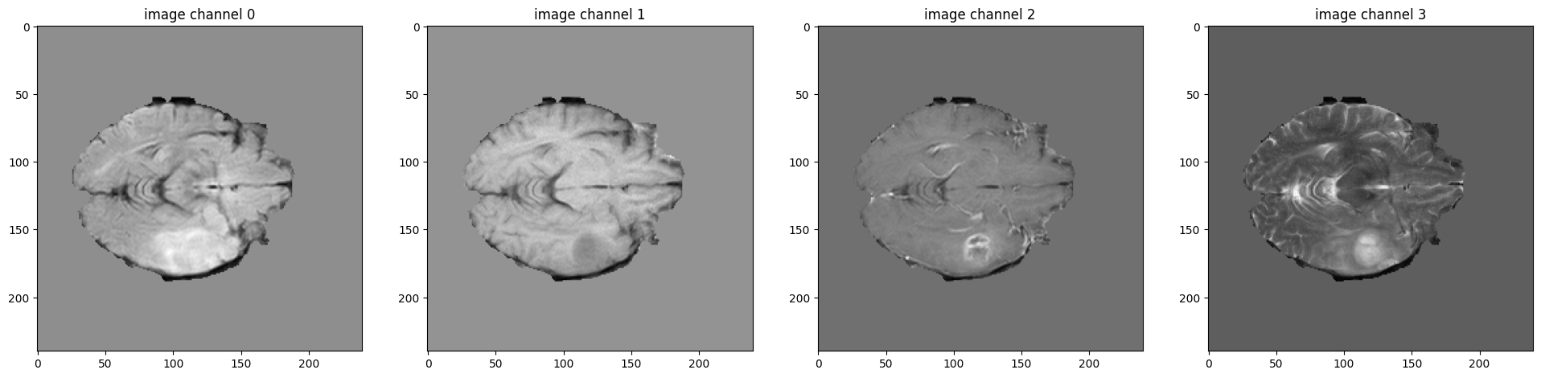
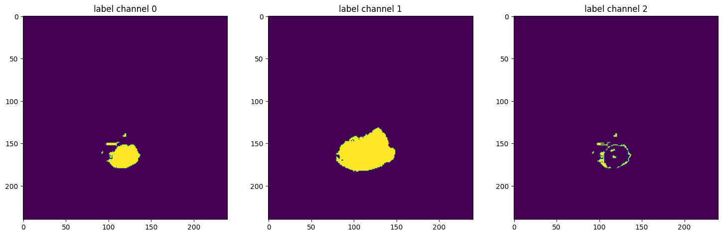
Implementation
Dataset
Source: Medical Segmentation Decathlon (MSD)
80% training, 20% validation
484 mp-MRI images from patients diagnosed with either glioblastoma or lower-grade glioma

Slide 19
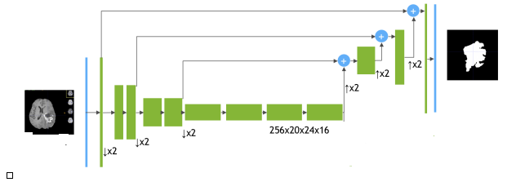
Implementation
SEGRESNET Architecture
Based on ResNet, a CNN model
SEGRESNET uses skip connections
ResNet has powerful feature extraction capabilities
Encoder-decoder based architecture
Schematic visualization of the network architecture
Architecture of each block

Slide 20
Implementation
Encoder
The encoder part uses ResNet blocks, where each block consists of two convolutions with normalization and ReLU, followed by additive identity skip connection.
For normalization, we use Group Normalization (GN), which shows better than BatchNorm performance when batch size is small (bath size of 1 in our case).
We follow a common CNN approach to progressively downsize image dimensions by 2 and simultaneously increase feature size by 2. For downsizing we use strided convolutions.

Slide 21
Implementation
Decoder
The decoder structure is similar to the encoder one, but with a single block per each spatial level.
Each decoder level begins with upsizing: reducing the number of features by a factor of 2 (using 1x1x1 convolutions) and doubling the spatial dimension (using 3D bilinear upsampling), followed by an addition of encoder output of the equivalent spatial level.
The end of the decoder has the same spatial size as the original image, and the number of features equal to the initial input feature size, followed by 1x1x1 convolution into 3 channels and a sigmoid function.

Slide 22
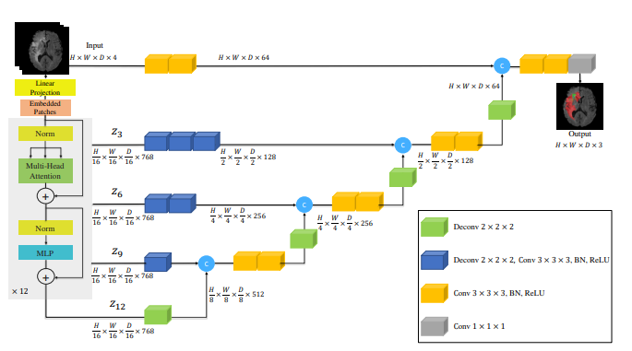
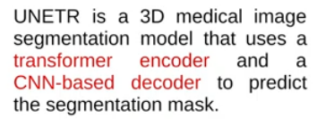
Implementation
UNETR Architecture

Slide 23
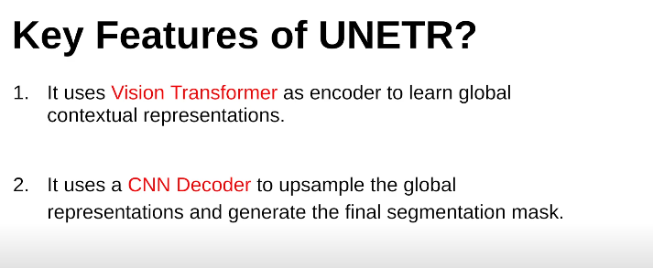
Implementation

Slide 24
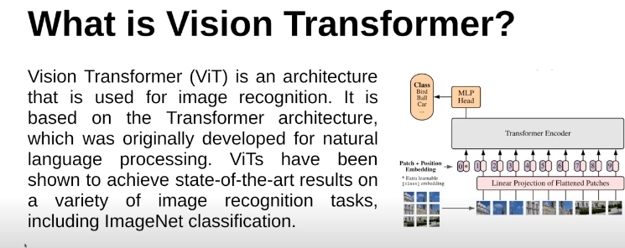
Implementation

Slide 25
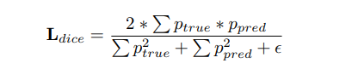

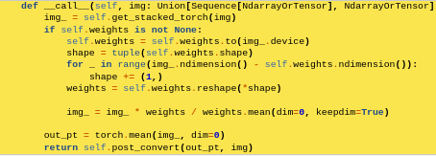
Implementation
Training
Loss function
Optimizer function
Ensemble

Slide 26
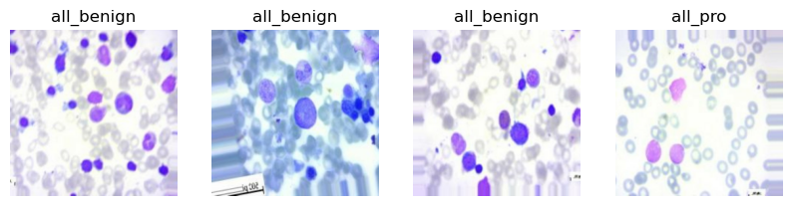
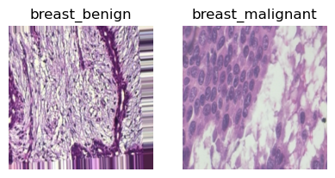
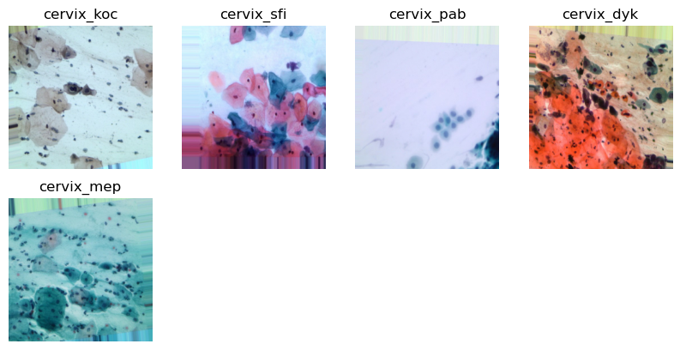
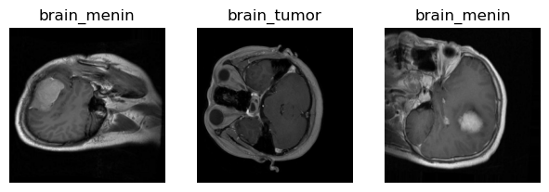
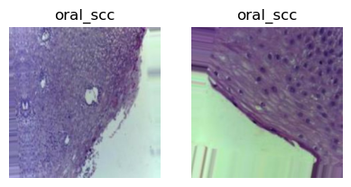
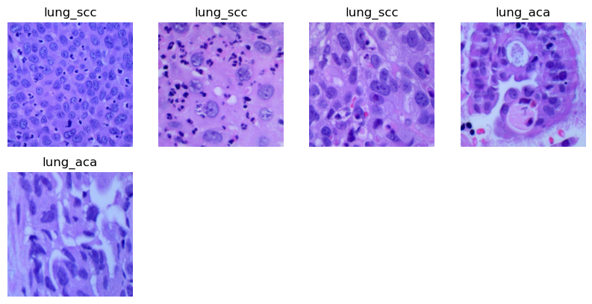
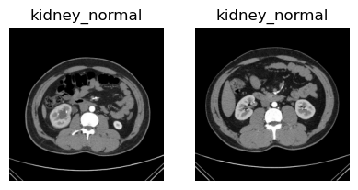
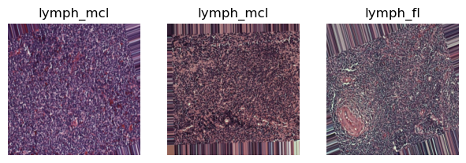
Implementation
Implementation of Classification Models

Slide 27
Neural Networks
What is a neuron?
What is a neural network?
What is a Convolutional Neural Network?

Slide 28
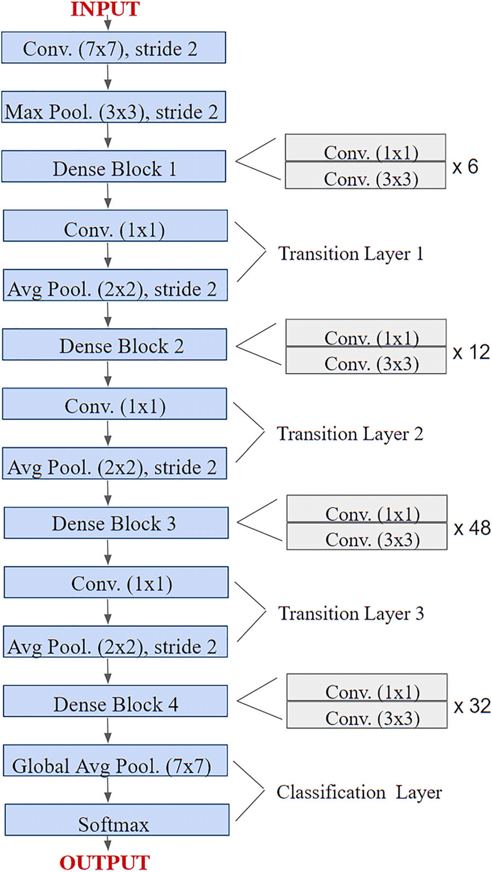
Implementation
DenseNet-201
Dense convolutional network
Basic building block - dense block
201 layers
Addresses vanishing gradients
Strengthens feature propagation

Slide 29
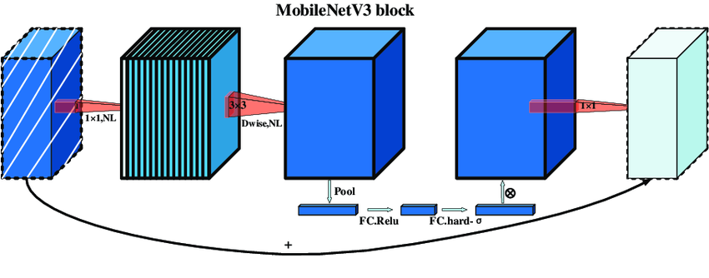
Implementation
MobileNetv3Small
Lightweight MobileNetv3
Balance between model size and accuracy
Depth-wise separable convolutions
Inverted residuals
Efficient use of activations

Slide 30
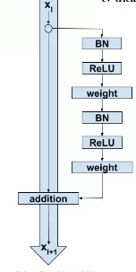
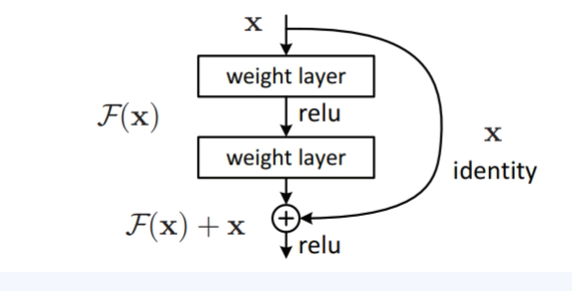
Implementation
ResNet50v2
Residual network architecture
50 layers
Building blocks - residual blocks
Residual connections
Identity mapping
Bottleneck structure
Pre-activation
Deeper architecture
Residual Blocks
RESNETv2
Architecture

Slide 31
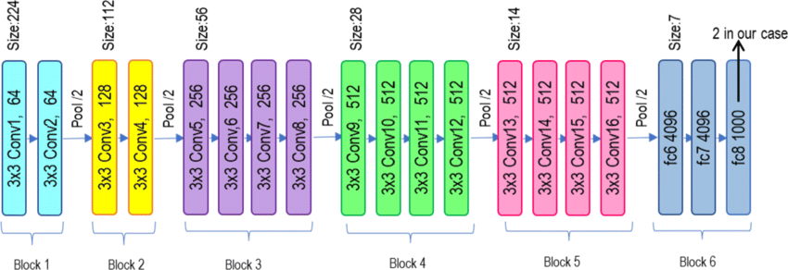
Implementation
VGG19 Architecture
Visual Geometry Group, 19 layers
Convolutional layers, max pooling layers, fully connected layers, increasing depth
Captures both local and global information from images

Slide 32
Implementation
Training
Optimiser - Adam Optimiser
Adam + RMSprop
Adaptive Learning Rates
Momentum Optimization
Bias Correction
Weight Decay
Computational Efficiency
Set learning rate = 0.01
Annealer - ReduceLROnPlateau
ReduceLROnPlateau
Monitor Metric
Patience
Factor
Mode
Threshold
Cool-down
“ReduceLROnPlateau(monitor='val_accuracy', factor=0.5, patience=5, verbose=1, min_lr=1e-3)”

Slide 33
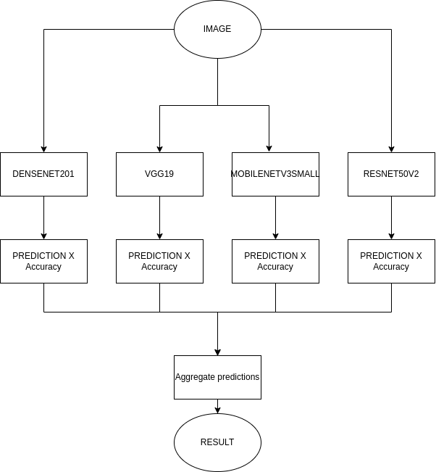
Implementation
Ensemble
ML technique that involves combining multiple individual models, called base models or weak learners, to create a more robust and accurate prediction model.
We have tried to ensemble the predictions of all the models based on the accuracy as a heuristic knowledge to weight the predictions of each model.

Slide 34
Performance Metrics
Metrics Used for Segmentation
Dice score
Metrics Used for Classification
Performance metrics
Confusion matrix
Accuracy
Precision
Recall or sensitivity
F1 score

Slide 35
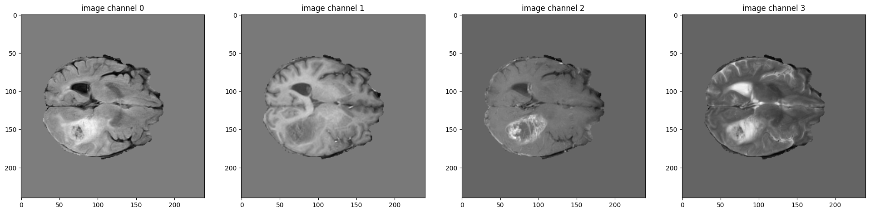
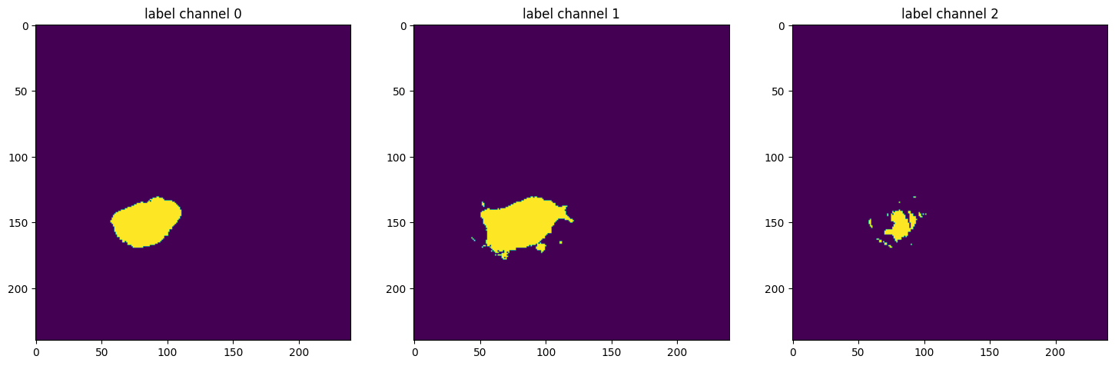
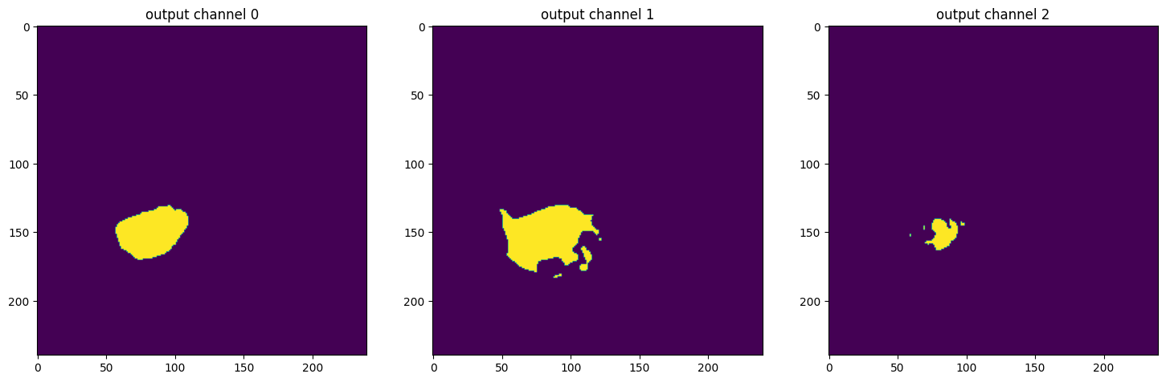
Performance Analysis
Result for Brain Tumor Segmentation - SEGRESNET
Dice Scores:
Metric on original image spacing: 0.7625482082366943
Metric for tumor Core: 0.8078
Metric for Whole tumor: 0.9002
Metric enhancing tumor: 0.5796
Results achieved at 63 epochs
Original Image
Ground Truth
Output

Slide 36

Performance Analysis
Brain Tumor Segmentation - UNETR
Dice Scores:
Metric on original image spacing: 0.737675666809082
Metric tumor Core: 0.7786
Metric Whole tumor: 0.8912
Metric Enhancing tumor: 0.5432
Results achieved at 47 epochs
Original Image
Ground Truth
Output

Slide 37

Performance Analysis
Brain Tumor Segmentation - Mean Ensemble
Dice Scores:
Metric on original image spacing: 0.7645719647407532
Metric Tumor Core: 0.8091
Metric Whole tumor: 0.9032
Metric enhancing tumor: 0.5814
Ground Truth
Model Output

Slide 38
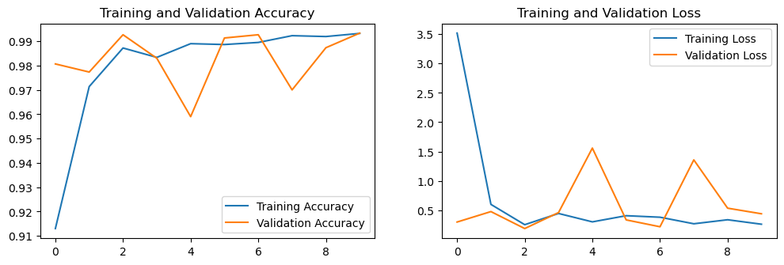
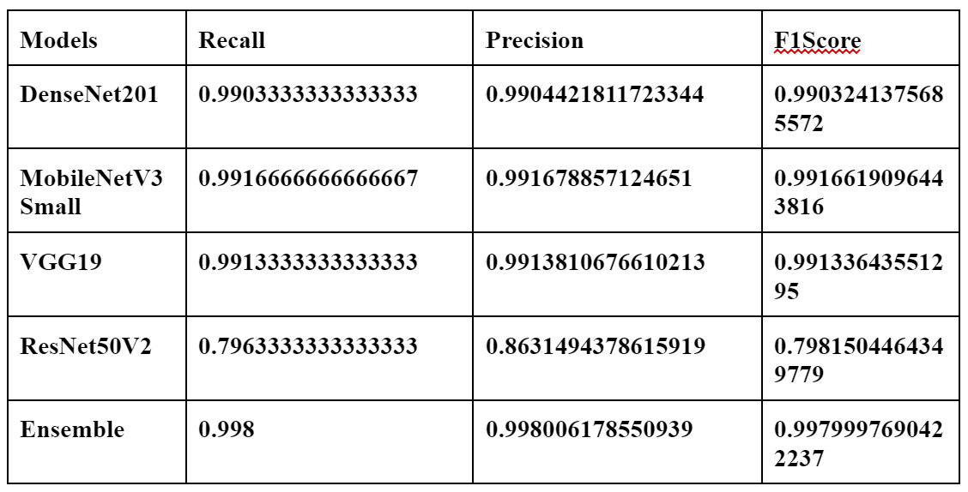
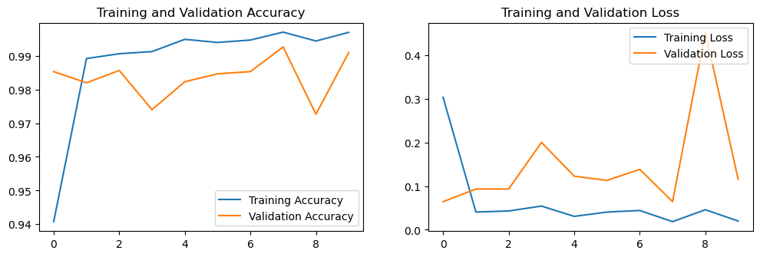
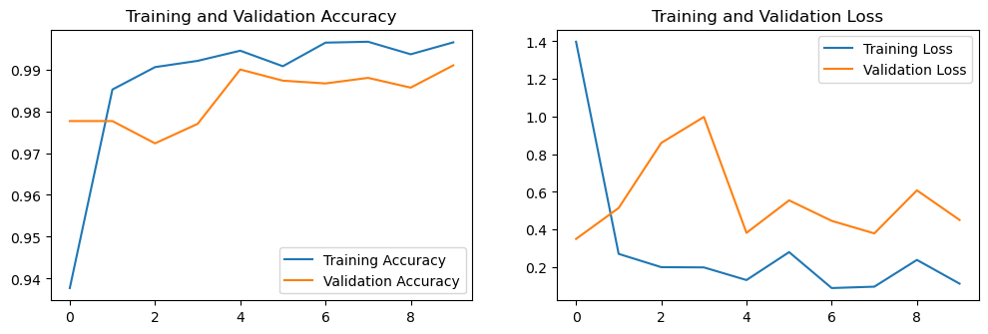
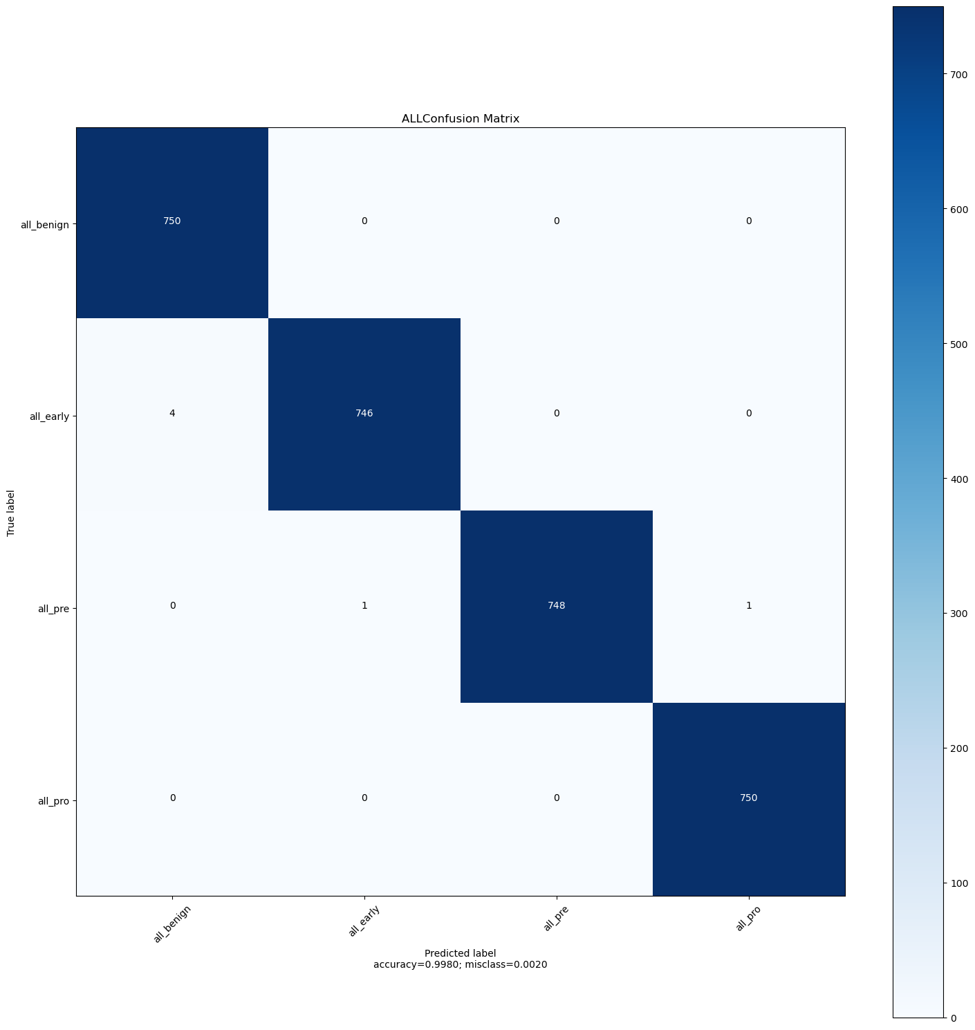
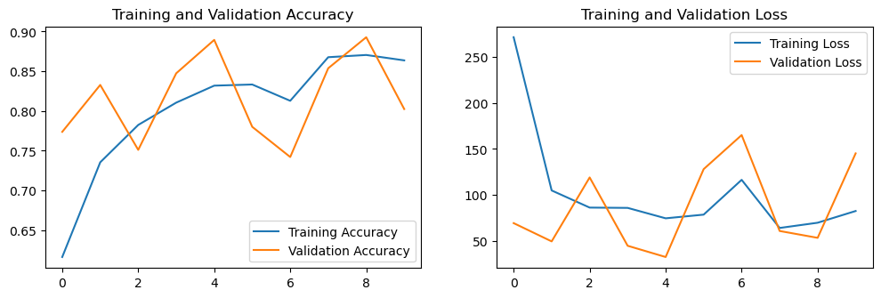
Performance Analysis
Acute Lymphoblastic Leukemia
DenseNet201
MobileNetv3Small
VGG19
Ensemble
ResNet50V2

Slide 39
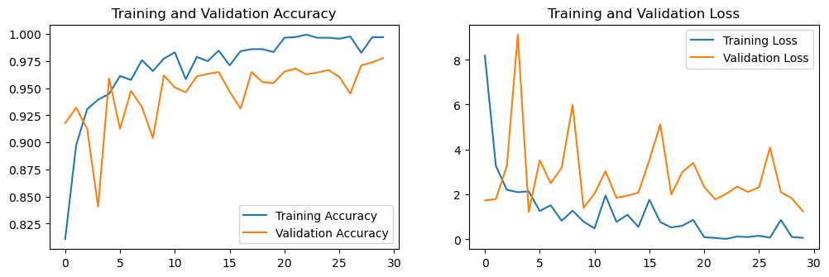
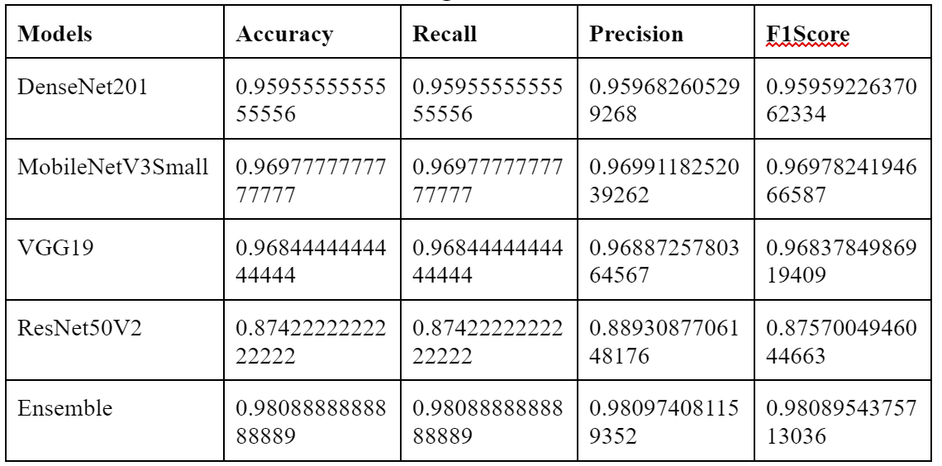
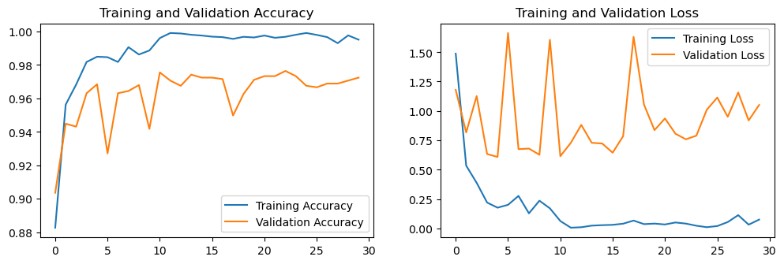
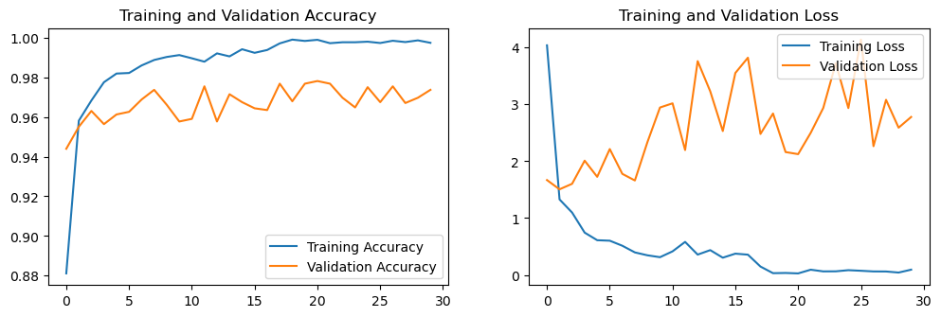
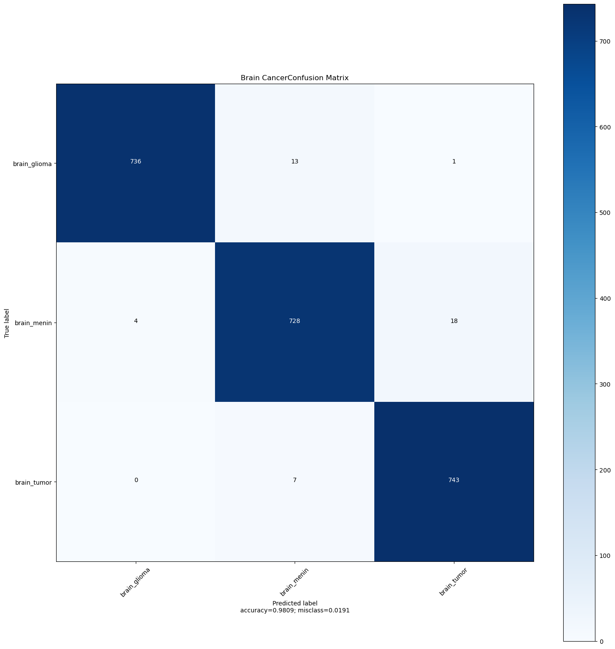
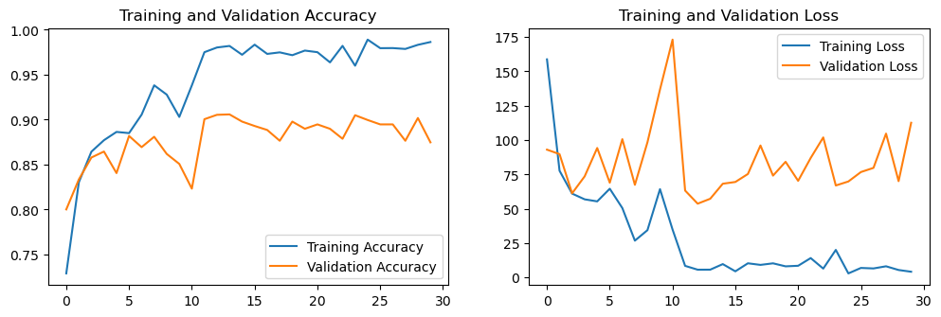
Performance Analysis
Brain Cancer
DenseNet201
MobileNetv3Small
VGG19
Ensemble
ResNet50V2

Slide 40
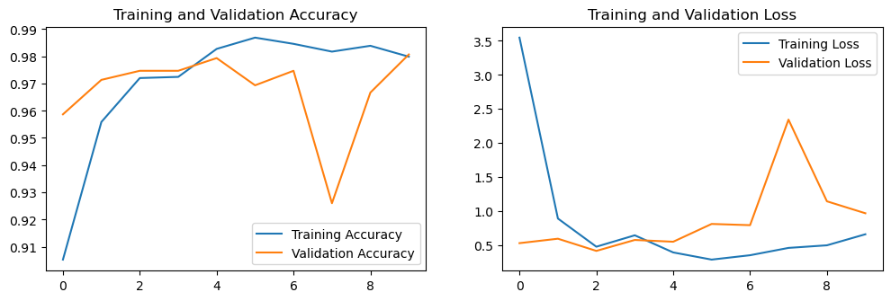
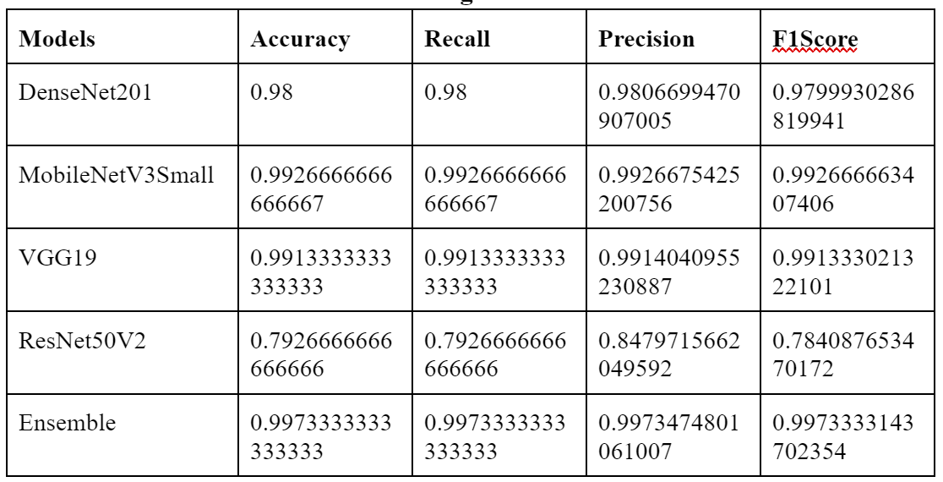
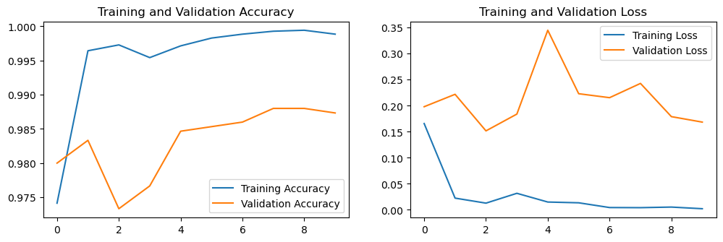



Performance Analysis
Breast Cancer
DenseNet201
MobileNetv3Small
VGG19
Ensemble
ResNet50V2

Slide 41






Performance Analysis
Cervical Cancer
DenseNet201
MobileNetv3Small
VGG19
Ensemble
ResNet50V2

Slide 42





Performance Analysis
Kidney Cancer
DenseNet201
MobileNetv3Small
VGG19
Ensemble
ResNet50V2

Slide 43






Performance Analysis
Lung and Colon Cancer
DenseNet201
MobileNetv3Small
VGG19
Ensemble
ResNet50V2

Slide 44






Performance Analysis
Lymphoma
DenseNet201
MobileNetv3Small
VGG19
Ensemble
ResNet50V2

Slide 45






Performance Analysis
Oral Cancer
DenseNet201
MobileNetv3Small
VGG19
Ensemble
ResNet50V2

Slide 46
Conclusion and Future Work
Managed to build 2 models and tried to ensemble it to segment brain tumors and achieved desirable results
Ensemble-based approaches offer significant advantages in medical image classification and segmentation. They enhance the performance, robustness, and generalization capabilities of the system, enabling more accurate diagnoses and treatment decisions. Leveraging the power of ensembles can lead to improved healthcare outcomes and contribute to advancements in medical imaging technology.
Conclusion: The detection of cancer using machine learning techniques offers several advantages that can significantly impact healthcare and improve patient outcomes. Traditional cancer diagnosis often requires extensive manual analysis and interpretation of medical images and biopsy samples, which can be time-consuming. Machine learning algorithms can automate and expedite the diagnostic process, analyzing images and data in a fraction of the time, thereby reducing waiting times for patients and enabling faster treatment initiation.

Slide 47
Conclusion and Future Work
Scope for improvement:
Bigger dataset
Cross-validation ensemble
Swin-UNETR Architecture
Better validation data sourced through key radiologists
Future Work:
More and potentially better models
Creating bigger ensemble

Slide 48
References
[1] Abadi, Martın et al., “Tensorflow: Large-scale machine learning on heterogeneous distributed systems” (2016).
[2] Abraham, Nabila and Naimul Mefraz Khan, “A novel focal tversky loss function with improved attention u-net for lesion segmentation” (2019).
[3] Anithadevi, D and K Perumal, “A hybrid approach based segmentation technique for brain tumor in MRI Images” (2016).
[4] Hatamizadeh A, Tang Y, “Unetr: Transformers for 3d medical image segmentation” (pp. 574-584), (2022).
[5] Myronenko A, “3D MRI brain tumor segmentation using autoencoder regularization” (2019).
[6] Gu, Shanqing, Manisha Pednekar and Robert Slater, “Improve Image Classi- fication Using Data Augmentation and Neural Networks” (2019).
[7] Salçin, Kerem et al, “Detection and classification of brain tumors from MRI images using faster R-CNN” (2019).
[8] Jonas Prellberg, Oliver Kramer, “Acute Lymphoblastic Leukemia Detection from Microscopic Images Using Weighted Ensemble of Convolutional Neural Networks” (2019).
[9] Marco Aurélio Granero, Cristhian Xavier Hernández, Marcos Eduardo Valle, “Quaternion-Valued Convolutional Neural Network Applied for Acute Lymphoblastic Leukemia Diagnosis” (2021).
[10] Md Zahangir Alom, Chris Yakopcic, Tarek M. Taha, Vijayan K. Asari, “Breast Cancer Classification from Histopathological Images with Inception Recurrent Residual Convolutional Neural Network” (2018).
[11] Aditya Golatkar, Deepak Anand, Amit Sethi, “Classification of Breast Cancer Histology using Deep Learning” (2017).
[12] Rishav Pramanik, Momojit Biswas, et al, “A fuzzy distance-based ensemble of deep models for cervical cancer detection” (2019).
[13] Nanditha B R, Geetha Kiran A Sanathkumar M P, “Oral Cancer Detection using Machine Learning and Deep Learning Techniques” (2021).
[14] Panwar, S.A., Munot, M.V., Gawande, S. and Deshpande, “A reliable and an efficient approach for diagnosis of brain tumor using transfer learning” (pp.283-294), (2021).
[15] Ullah, N., Khan, J.A., Khan, M.S., Khan, W., Hassan, I., Obayya, M., Negm, N. and Salama, A.S, “An Effective Approach to Detect and Identify Brain Tumors Using Transfer Learning. Applied Sciences” (2022).
[16] Dalia Alzu’bi,Malak Abdullah, et.al, “Kidney Tumor Detection and Classification Based on Deep Learning Approaches: A New Dataset in CT Scans” (2022).
[17] Md. Alamin Talukder, Md. Manowarul Islam, et.al, “Machine Learning-based Lung and Colon Cancer Detection using Deep Feature Extraction and Ensemble Learning” (2022).
[18] Satvik Garg, Somya Garg, “Prediction of lung and colon cancer through analysis of histopathological images by utilizing Pre-trained CNN models with visualization of class activation and saliency maps” (2021).
[19] Maria Frucci, Daniel Riccio, et.al, “A Deep Learning Approach for Breast Invasive Ductal Carcinoma Detection and Lymphoma Multi-Classification in Histological Images” (2021).
[20] Zeyad Ghaleb Al-Mekhlafi, Ebrahim Mohammed Senan, et.al, “Diagnosis of Histopathological Images to Distinguish Types of Malignant Lymphomas Using Hybrid Techniques Based on Fusion Features” (2022).

Slide 49
THANK YOU

